Slide 1
HEALTH & ILLNESS

Slide 2
HEALTH
SICKNESS
RECOVERY

Slide 3
HEALTH
What is your general health like?
How’s your health, generally?

Slide 4
HEALTH
Be in good health = well, no illness (disease)
Be healthy = normally well, can resist illness
Be fit = well and strong

Slide 5
HEALTH
Fit
Unfit
In good health
In poor health
NOT ILL
Well/
Very well
Unwell/not well/
not very well
ILL
Fit and well
Poorly
Healthy
Unhealthy

Slide 6
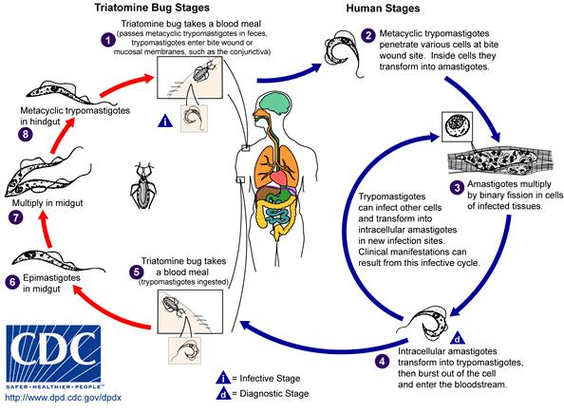
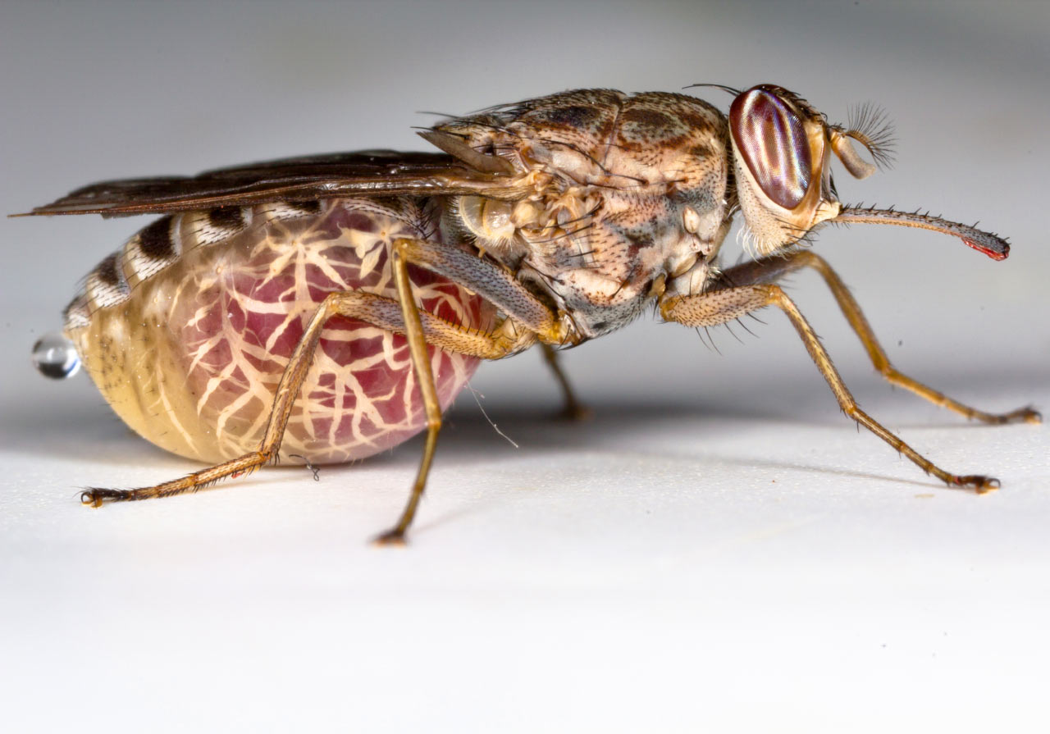
SICKNESS
Sleeping sickness
From: sci-news.com
From: Healthtap.com

Slide 7
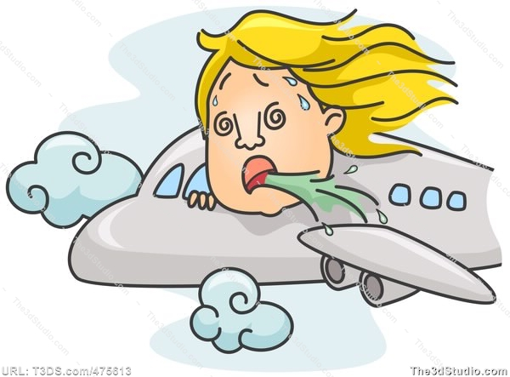
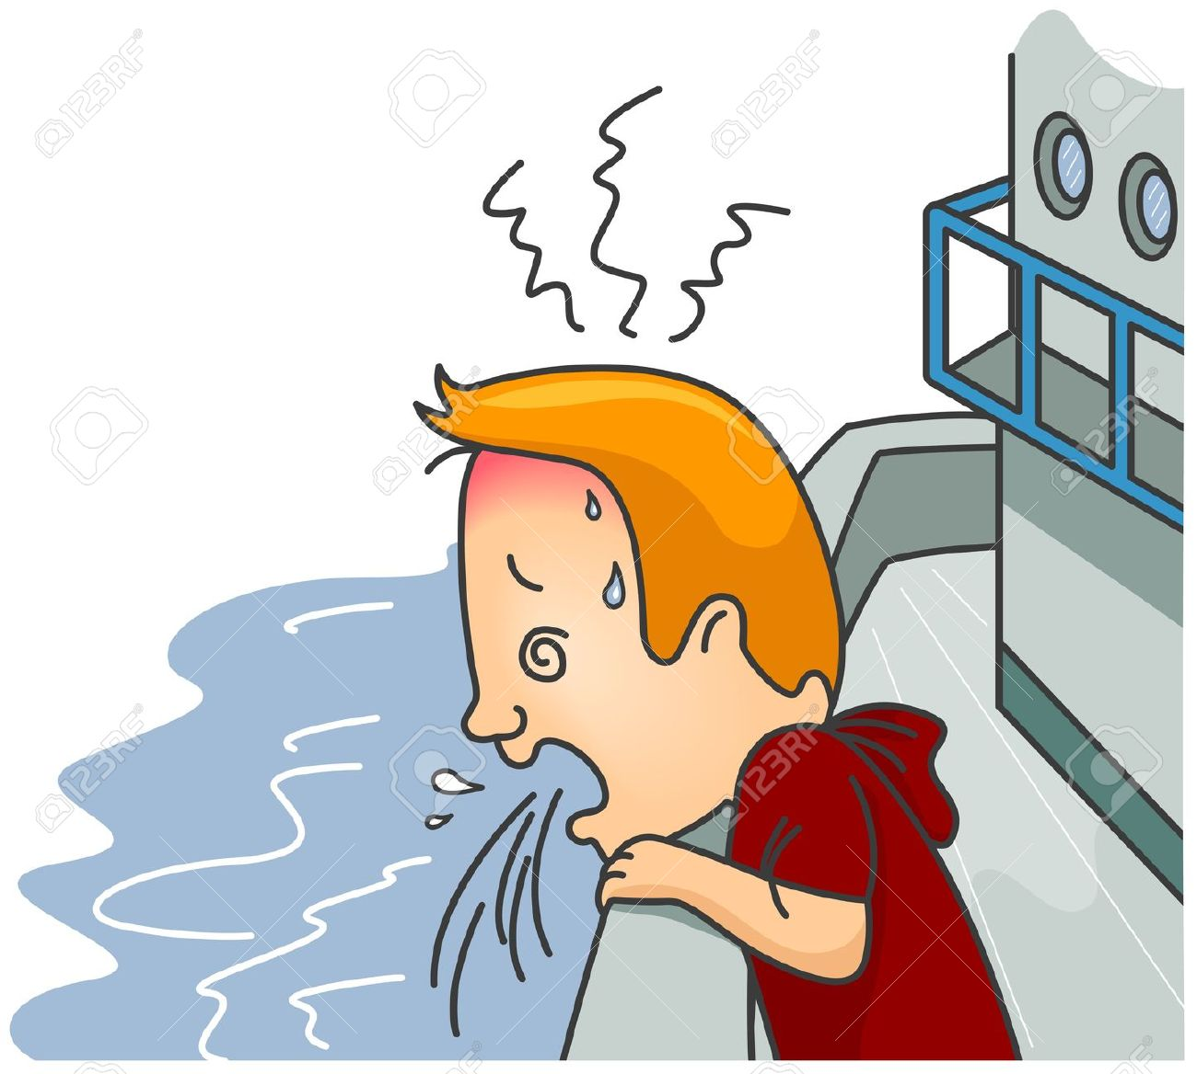
SICKNESS
Travel sickness
From: Hipnosisisacureforme.com
From: 123rf.com

Slide 8
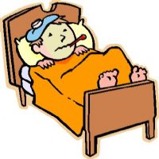
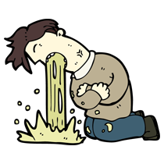
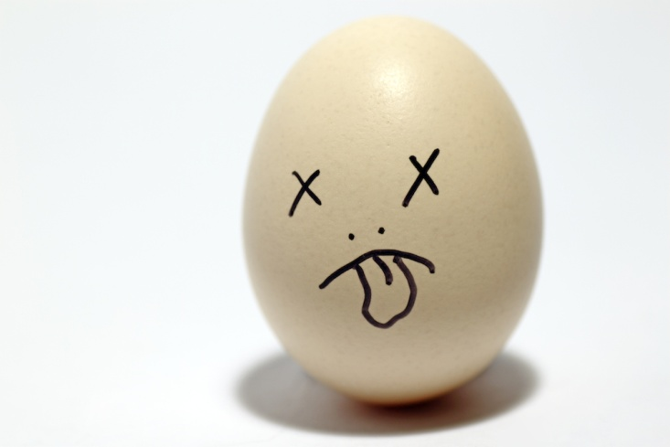
SICKNESS
I was sick this morning. | I was ill this morning. I felt unwell this morning. I vomited this morning.
From: edumax.edu.vn
From: canadianpaleoathletic.com
From: devotsthoughs.com

Slide 9
SICKNESS
I feel sick. | I feel ill. I feel unwell. I am nauseous. I feel the need to vomit.
Sickness and diarrhea = vomiting and diarrhea

Slide 10
RECOVERY
The patient | made a | good full complete | recovery.

Slide 11
RECOVERY
Be in the process of returning to normal: be improving
Improving ≠ deteriorating
The patient’s condition improved/deteriorated.

Slide 12
RECOVERY
GET | over (an illness) | = to recover
 | Better | = to improve
 | worse | = to deteriorate
Be better, then get worse again→ The patient has relapsed.

